Slide 1
Unit 5
(Environmental Policies & Practices)
Lecture 21
(Solid waste management: Control measures of urban and industrial waste)
1

Slide 2
Learning outcomes
After completing this lecture, you will be able to understand the following:
Student get knowledge about Solid waste and their effect on Human health and Environment.
Student aware about solid waste management and their benefits.
2

Slide 3
Solid Waste
and
Solid Waste Management
3

Slide 4
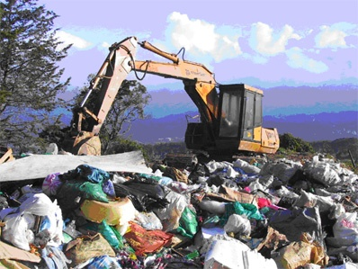
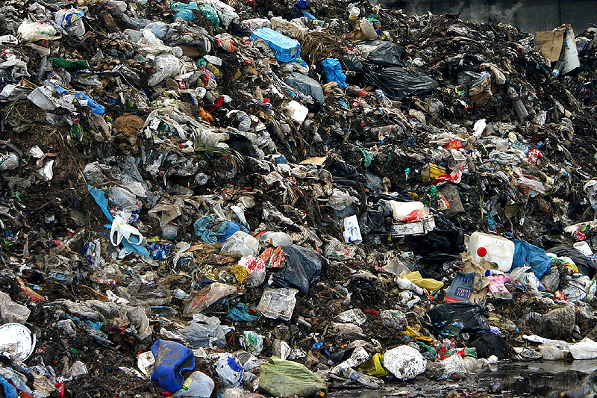
Solid Waste
Solid waste includes domestic wastes, commercial wastes, and industrial wastes collected by a municipality within a given area. It is responsible for land pollution in urban and industrial areas.
4

Slide 5
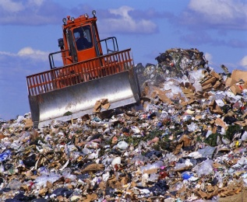
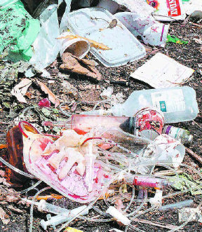
Important Sources of Solid Waste
Domestic garbage- household waste.
Industrial waste-
Commercial waste
Mining waste
Radioactive waste
Agricultural waste
Hospital waste
E-waste
https://www.youtube.com/watch?v=EUQ0FxzvK9o
5

Slide 6
Effects of Solid Waste
Solid waste helps disease-causing organisms such as mosquitoes, flies, etc., to thrive freely and increase in population.
It runs off with rainwater and mixes with the nearby water bodies causing water pollution.
Burning of solid waste leads to air pollution.
6

Slide 7
Effects of Solid Waste cont.……..
Radioactive substances present in solid waste cause a number of diseases in human beings.
Solid waste reduces the aesthetic value of land.
Non-biodegradable solid wastes such as polythene, plastic, rubber, etc., obstruct the sewage system and release toxic gases when burnt hence causing air pollution.
https://www.youtube.com/watch?v=QW0hjT7adV8
7

Slide 8
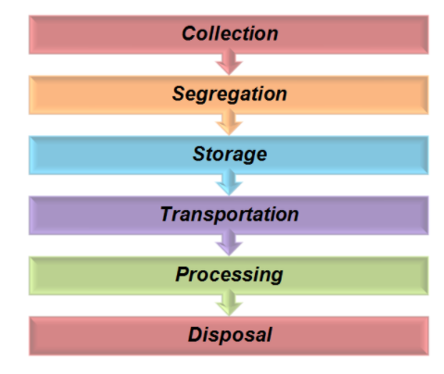


Solid waste management
Solid waste management may be defined as the discipline associated with the control of generation, storage, collection, transfer, processing and disposal of solid waste
Solid waste management (SWM) is a Multi-step process includes:
8

Slide 9
Disposal Measures of Solid Waste
Open dumping- Method of waste disposal where refuse is disposed off in open dumps without being covered- leads to growth of mosquitoes and flies.
Land fill – waste is covered by thick layer of soil- contaminates ground water. Reduces risk of diseases.
Ocean dumping –Industrial effluents containing poisonous chemicals are dumped in ocean. Effects marine ecosystem.
9

Slide 10
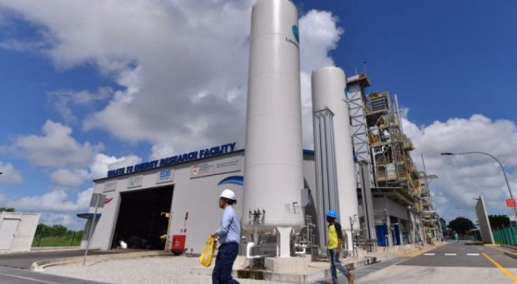
Disposal Measures of Solid Waste Conti………
Burning:
Combustible waste is burnt at high temp and they are converted to ash. Energy is used for electricity generation. Leads to air pollution and generation of toxic waste. Volume of waste is reduced.
10

Slide 11
Disposal Measures of Solid Waste Conti………
Composting: Biochemical degradation of organic material to yield soil supplement. It is an eco-friendly method.
Drawback- necessity to separate organic waste from other waste.
Source Reduction: This is best possible method. Over-consumption and wastage of commodities can be checked by adopting 5 Rs:
11

Slide 12
5 Rs of Solid Waste Management
Refuse: Refuse unnecessary goods and services. Ex- to minimize the disposal of plastic carry bags, it is best to minimize their use.
Reduce: Reduce consumption of goods and services.
Reuse: To minimize waste is to reuse goods. This reduces demand for new goods.
Repair: Repair broken goods and try to use them for a longer time.
Recycle: Recycle goods.
https://www.youtube.com/watch?v=HLxbwCAYy_M
12

Slide 13
Important Video/Web Link
https://ec.europa.eu/echo/files/evaluation/watsan2005/annex_files/WEDC/es/ES07CD.pdf
http://collegesat.du.ac.in/UG/Envinromental%20Studies_ebook.pdf ,
https://www.youtube.com/watch?v=yhWnrNQPwAs
https://www.youtube.com/watch?v=aoi-Qno6x-8
13

Slide 14
Acknowledgment
Some images, animation, and material have been taken from the following sources:
Text Books: PERSPECTIVE IN ENVIRONMENTAL STUDIES by ANUBHA KAUSHIK, C P KAUSHIK, NEW AGE INTERNATIONAL PUBLISHERS
References Book: TEXT BOOK OF ENVIRONMENTAL STUDIES by D. DAVE AND S. S. KATEWA, CENGAGE LEARNING
3 All slides can be used for reading purpose only
14

